Slide 1
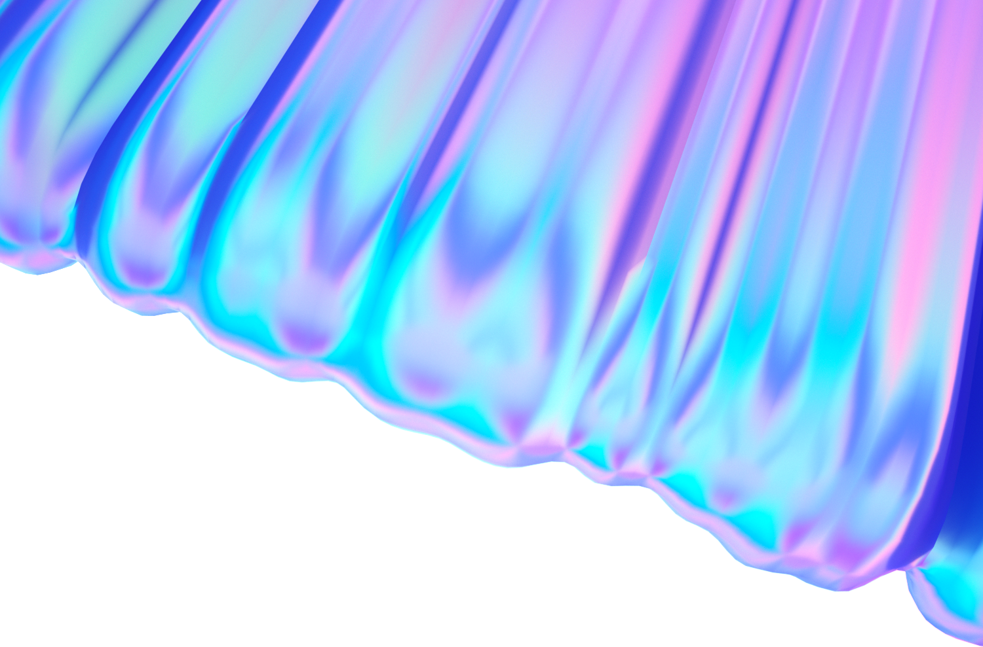
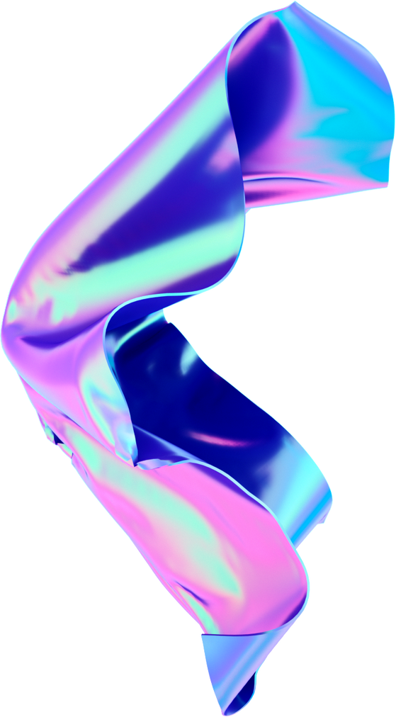


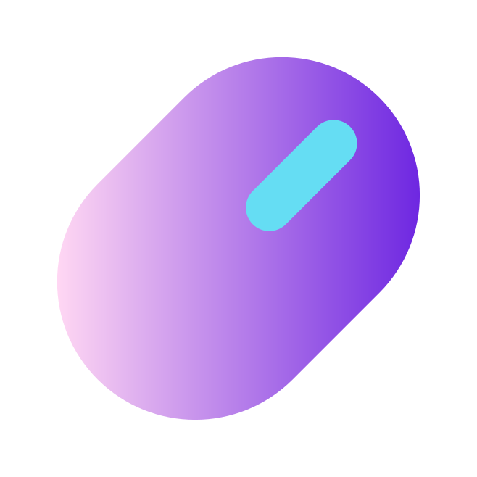
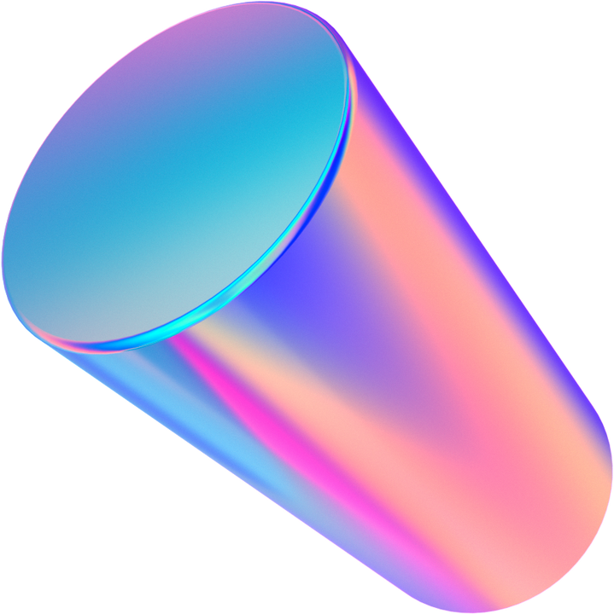
Milestone 2:
Health Monitoring App
Group 3: Alexandra Anthony, Sara Gaber, Ahmad Shah, Neeti Mistry, & Sohan Chatterjee
Notes:
Alex: 1, 2, 9, 10
Ahmad: 6
Sara: 5, 7
Neeti: 3, 4
Sohan: 8

Slide 2
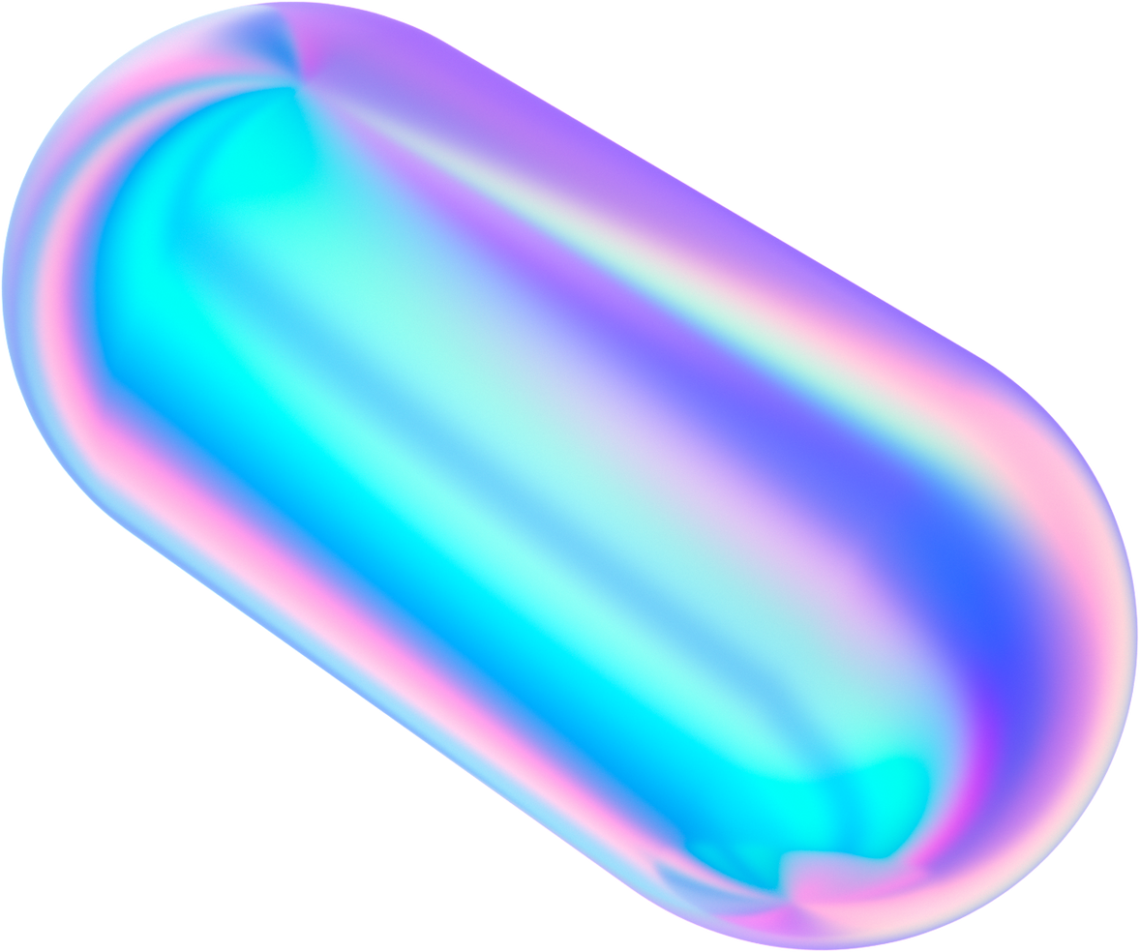
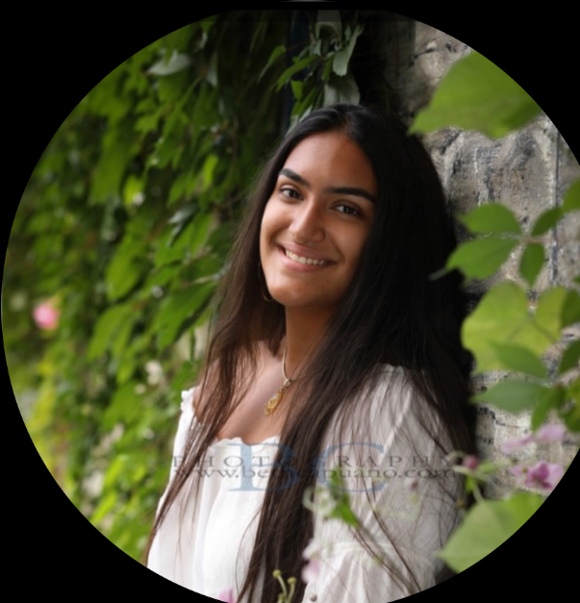
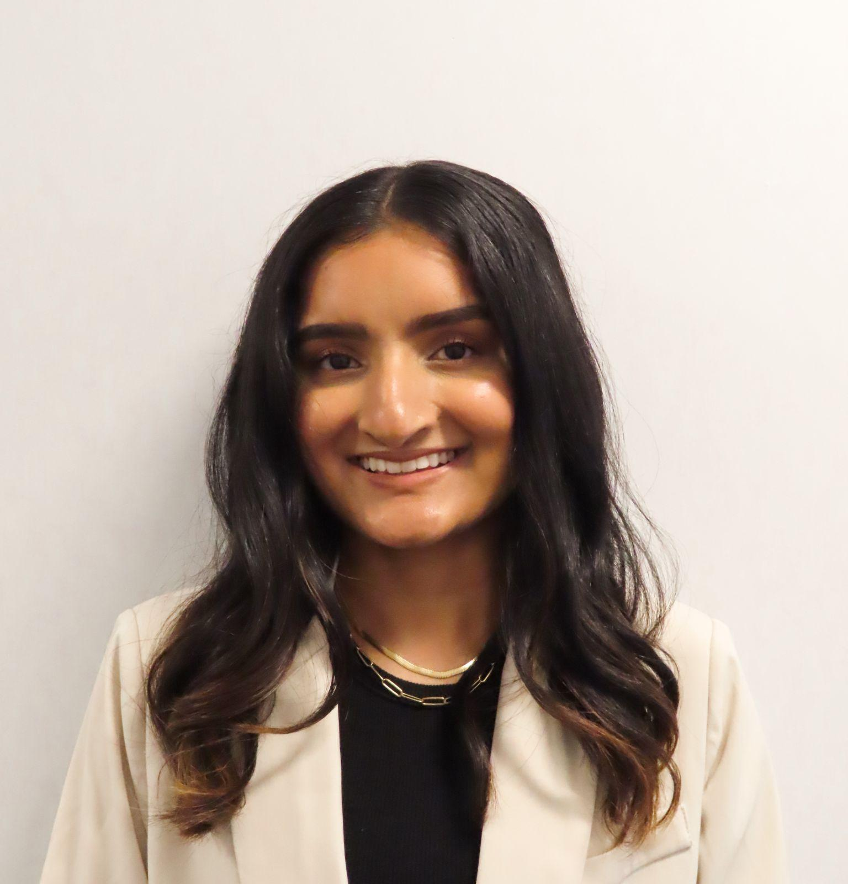



Team Members Intro and Roles
Alex
Neeti
Sara
GitHub Manager &
Class Diagram
Slides Manager &
Class Diagram
Use Case Diagram
Ahmad
Sohan
Activity Diagram
Sequence Diagram

Slide 3
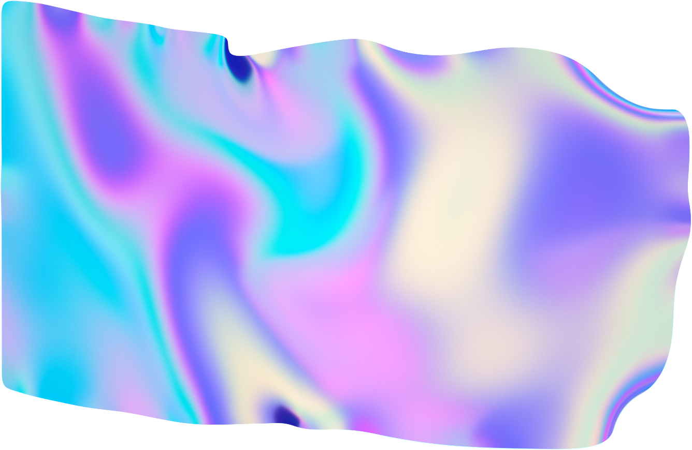
Introduction
UML diagrams are invaluable tools for understanding and documenting the various aspects of the system architecture and design
Use Case Diagram - Modeling user interactions and system functionality
Activity Diagram - Visualizing the workflow and process flows within the app
Class Diagram - Illustrating class structures and relationships
Sequence Diagram - Depicting the flow of messages and interactions between system components
Utilize appropriate modeling tools (Lucidchart) to create high-quality UML diagrams
Refine and finalize the diagrams iteratively, incorporating feedback from team members

Slide 4
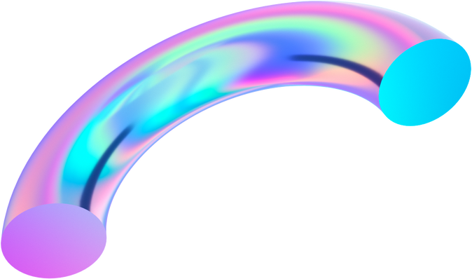
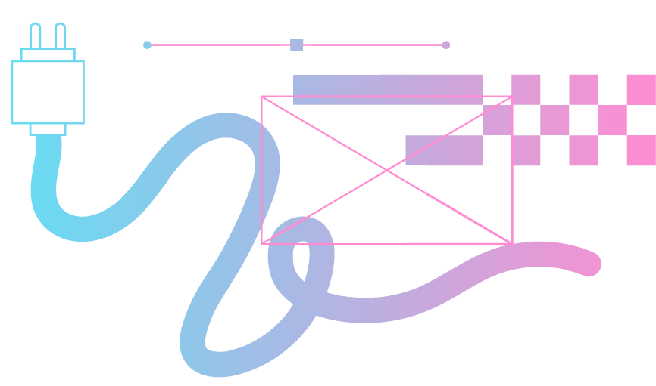
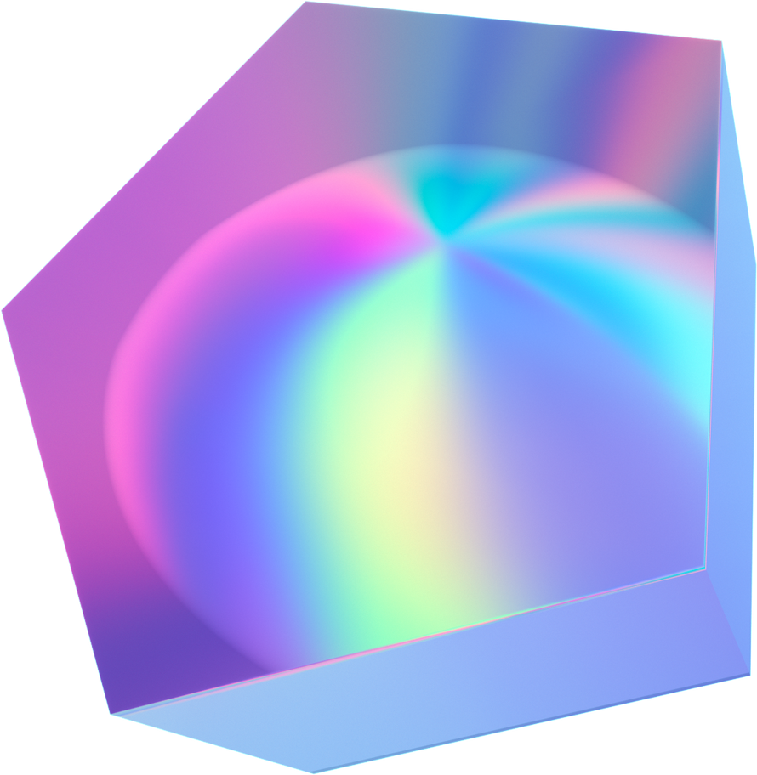
UML Diagrams
Create UML Diagrams to visually represent structure, design, and system architecture

Slide 5
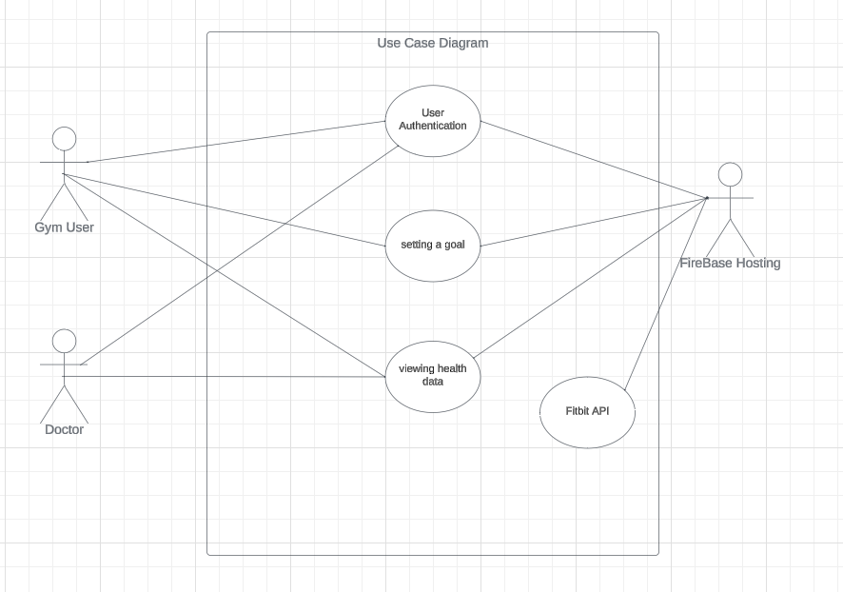
Use Case Diagram
User Authentication
Register and login
Preconditions: User must have internet access
Postconditions: User gains access to personalized health monitoring features
Setting a Goal
Allows users to set personalized health goals, such as daily step targets, calorie intake, etc
Preconditions: User must be logged in
Postconditions: User's health goals are saved and tracked within the app
Viewing Health Data
Enables users to view their health data, including steps, heart rate, sleep patterns, etc
Preconditions: User must be logged in
Postconditions: User can access and analyze their health metrics

Slide 6
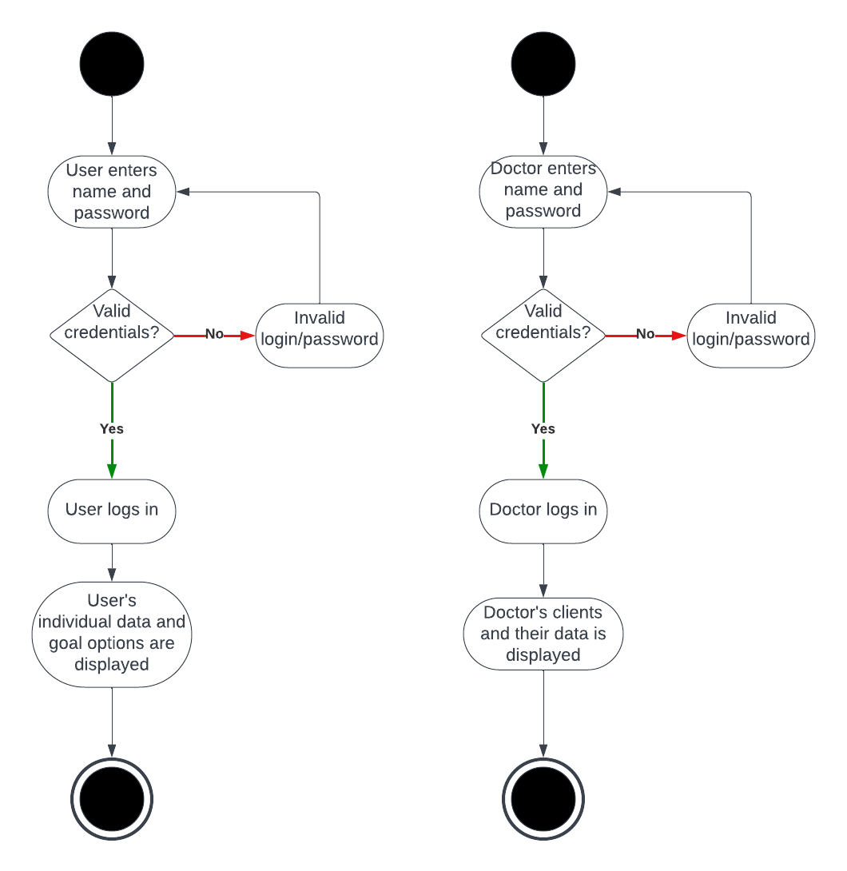
Activity Diagrams
Activity Diagrams - Separate for each user
Standard login/credential validation
Participant View
Displays individual, personalized data
Option to set single user goals
Doctor View
Displays all doctor clients
Displays each client’s data chosen to share
Displays each client’s goal progression

Slide 7
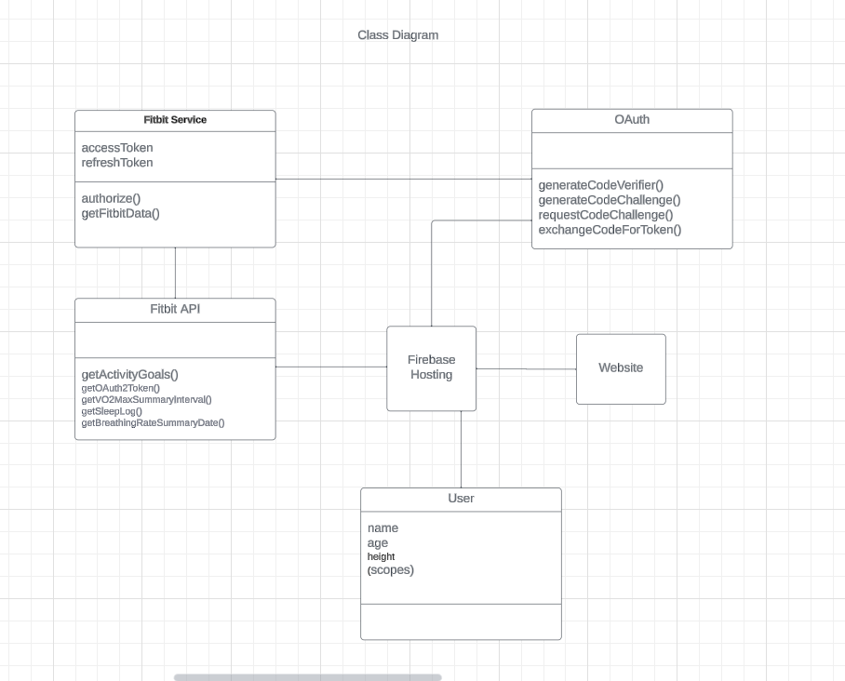
Class Diagram
Firebase Hosting
Represents the interface for integrating the health monitoring app with Firebase Hosting
User Class
Attributes include user information such as name, age, height, etc
Fitbit API
Represents the interface for interacting with the FitBit API
Fitbit Service
Represents the service responsible for integrating the health monitoring app with the Fitbit API
OAuth
Represents the OAuth integration for authenticating the health monitoring app
Website
Represents the main structure of the website

Slide 8
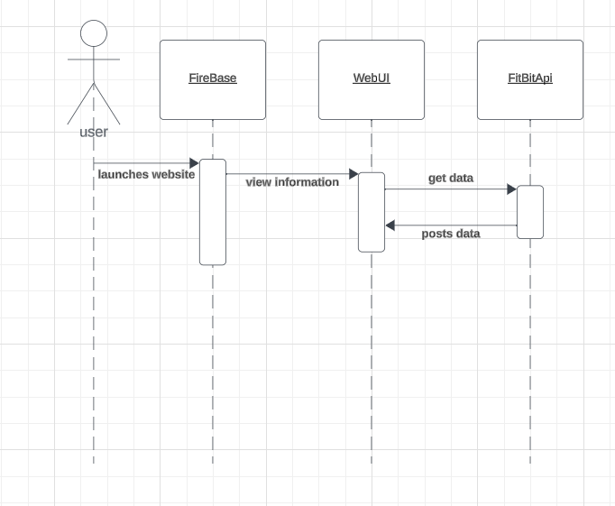
Sequence Diagram
The user launches the website
Can view their health information
Get health data
Posts health data

Slide 9
Summary
These UML diagrams provide comprehensive blueprint for our health monitoring app
By using these visual representations, we can ensure clarity, consistency, and coherence in our software development process
Use Case Diagram - Provided an overview of the interactions between users and the system, outlining the functionalities and user roles
Class Diagram - Illustrated the structure of our software system, depicting the classes, attributes, methods, and relationships among them
Activity Diagram - Presented the workflow or process flow within our system, showing the sequence of activities and actions
Sequence Diagram - Illustrated the interactions between system components or objects over time, capturing the dynamic behavior of our system
Regularly update and maintain UML diagrams to reflect any changes or updates in the project's architecture and design

Slide 10
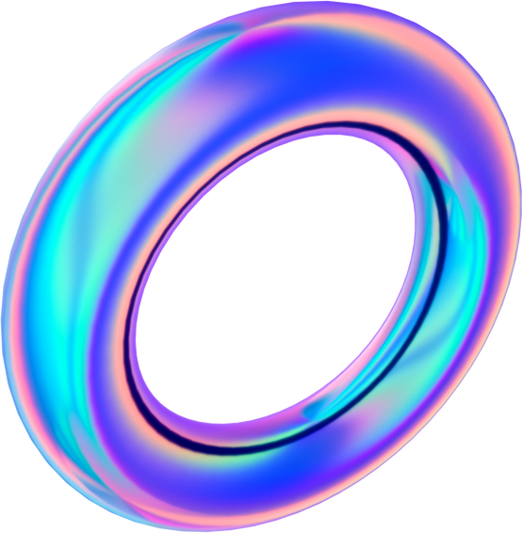

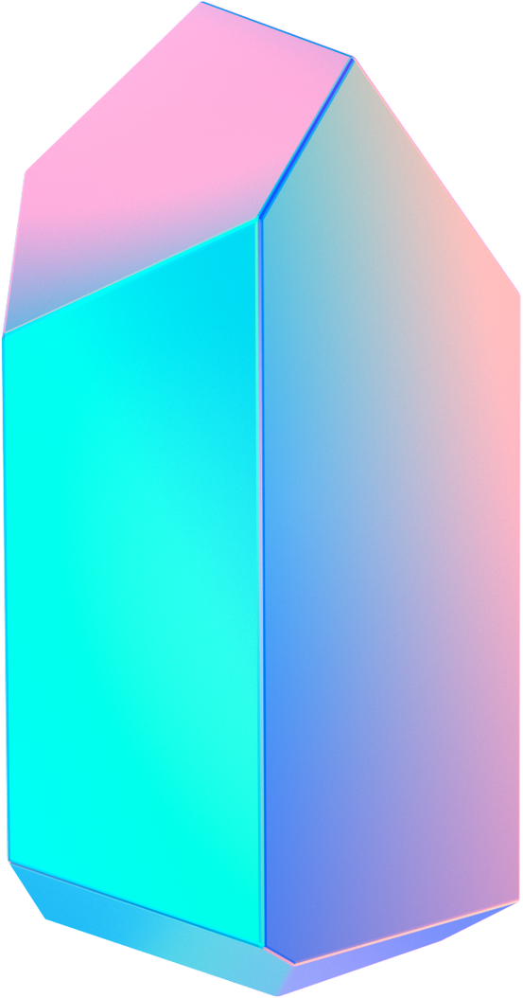
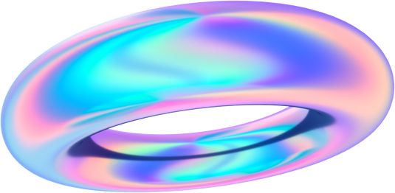
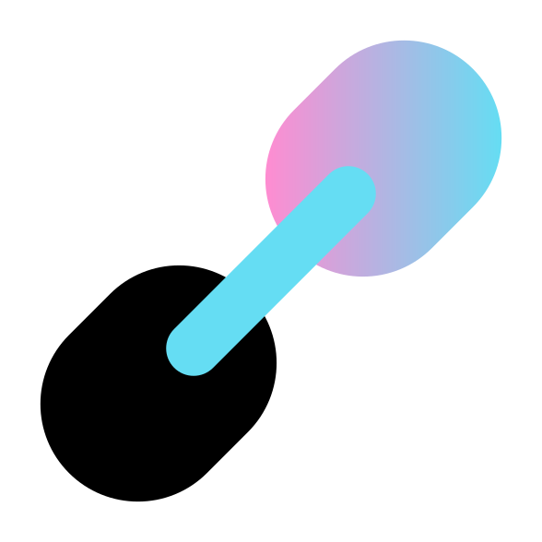
Thank you!
Any Questions?

